Slide 1
forensic
Trace element analysis
Determination of a specific element
(for example, Contact transfers)
Determination of a group of elements
(for example, gun shot residue)
Trace element profiling for characterization
(for example: metallic wire, opium)
Common contaminants in known and
questioned samples
Levels of constituents
major constituents 10 - 100 percent
minor constituents .1 - 10 percent
trace constituents 1 - 100 ppm
ultra trace constituents .001 - 1 ppm
ultra-ultra trace constituents less than .001 ppm
ranbsingh

Slide 2
Objects (material)
Natural
* major and minor constituents
controlled by nature (within specific range)
* trace constituents vary at random
* change with time (environment, source etc.)
Manufactured
* major and minor constituents
controlled by manufacturer (within specific range)
* trace constituents vary at random
* bulk production and wide distribution
ranbsingh

Slide 3
Trace element characterization of copper
Impurities detected
(NAA OES)
and
Antimony
Cobalt
Iridium
Nickel
Tellurium
Arsenic
Gold
Lead
Silver
Tin
Bismuth
Iron
Manganese
Selenium
Zinc
Neutron activation analysis
elements
recommended for
Ag, Se, Sb, Au
characterization
ranbsingh

Slide 4
Fifty six samples
from a hundred meter copper wire
Elements Ag Se Sb Au
Mean concentration 12.7 4.3 4.0 0.6
value in ppm
Coefficient of 3.5 4.2 2.2 3.8
variation(%)
ranbsingh

Slide 5
Comparison of copper wires
concentration in ppm
Ag Au Sb Se
Case A
questioned
14.0 0.51 7.0 2.7
known
could not be
0.2 0.03 2.2 0.7
distinguished
known
on the basis
0.3 0.03 2.1 0.7
Case B
of physical,
questioned
chemical,
14.0 0.52 7.0 2.7
and electrical
known
properties
7.9 0.06 0.5 4.5
known
14.0 0.52 7.0 2.7
ranbsingh

Slide 6

Ingot
Wire bars
Rolled wire rods
Hard drawn wire
Rod A
Rod B
known
obscure
known
ranbsingh

Slide 7
Three nineteen stranded cables A, B, C
Core - 1, 1st Ring - 6, 2nd Ring -12
ranbsingh

Slide 8
Different Strands of the same Cable having
indistinguishable impurity levels
Ag
Au
Sb
Se
A2
12.5
0.018
0.20
0.6
A3
12.3
0.017
0.22
0.6
A9
10.9
0.017
0.18
0.5
A10
11.0
0.019
0.19
0.5
B3
7.6
0.005
0.10
0.4
B9
7.6
0.004
0.08
0.3
B19
7.8
0.006
0.08
0.3
C14
12.1
0.011
0.13
0.5
C15
12.1
0.012
0.13
0.4
ranbsingh

Slide 9
Strands of different Cables having
similar impurity levels
Ag
Au
Sb
Se
B2
10.4
0.074
4.4
0.8
C17
10.1
0.074
4.0
0.8
Average values of impurity levels
in three different multi-stranded cables
A
10.25
0.0628
0.302
1.47
B
11.76
0.0464
2.413
0.65
C
11.97
0.0458
2.237
0.68
ranbsingh

Slide 10
Characterization of Metals by their
Trace Element Profile
is it a
Definitive Identification Technique
Multistranded Cables
comparison of trace element concentration in
corresponding strands yields conclusive results
(beyond reasonable doubts)
Wire (single strand)
- indistinguishable (highly consistent with)
- distinguishable (mismatch)
ranbsingh

Slide 11
Wire links transmitter with suspect terrorist
two pairs of flex from the transmitter A1, A2 & B1, B2
two pairs of flex from the suspect C1, C2 & D1, D2
Each had seven strands; 3-iron strands & 4-copper strands
Diameter of each strand was 0.27 mm
All the strands were marked sequentially and analyzed
Neutron Activation Analysis technique was used
Flexes could be grouped into; (1) A1, B1, C2, D2 and (2) A2, B2, C1, D1
The suspect was associated with the transmitter
ranbsingh

Slide 12

Physical correspondence of strands
ranbsingh

Slide 13
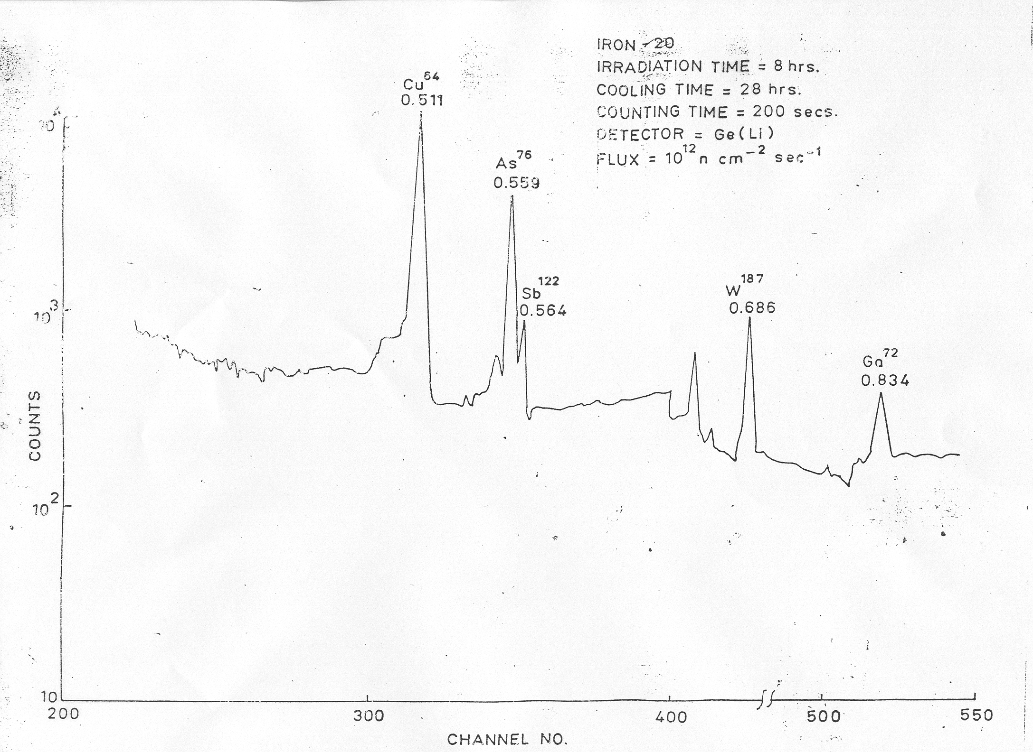
ranbsingh

Slide 14
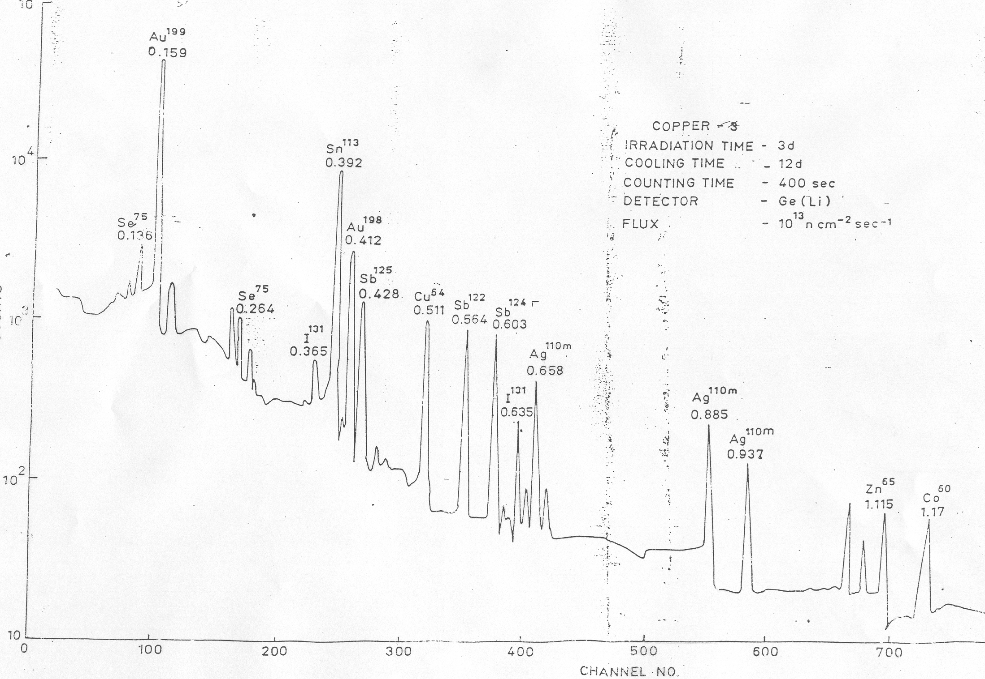
ranbsingh

Slide 15
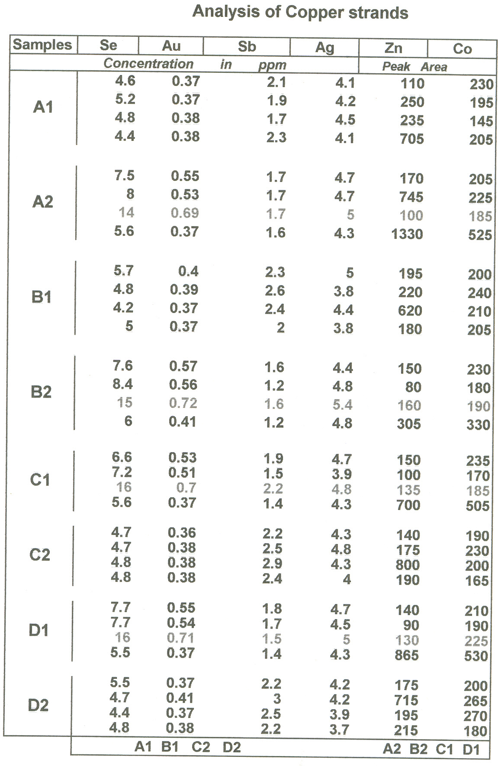
ranbsingh

Slide 16
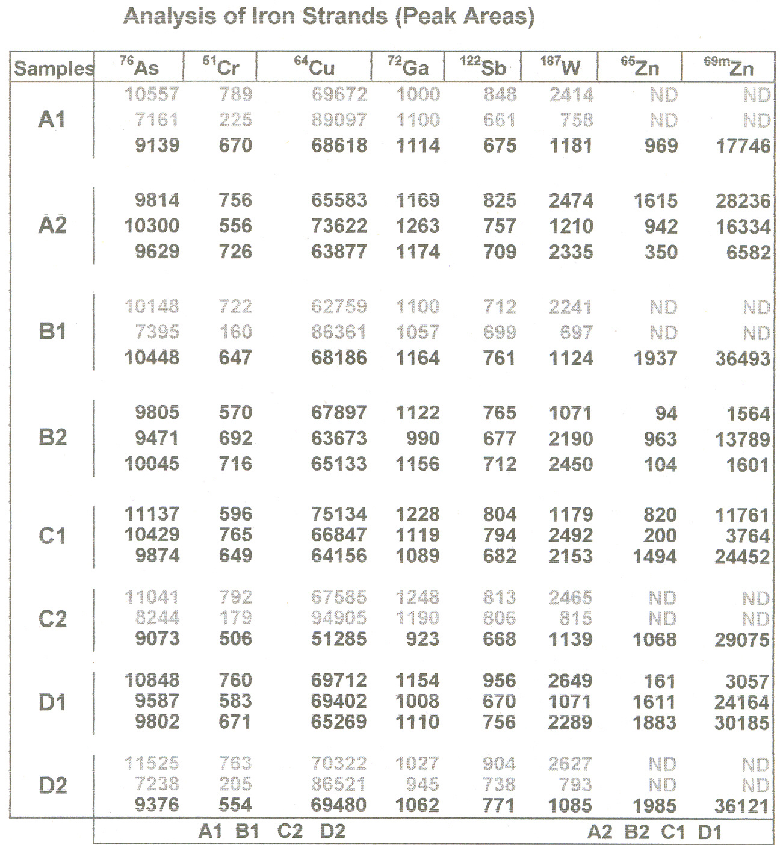
ranbsingh

Slide 17
Composition Of Bauxite
Moisture
1.0
Cr O
2
3
0.07
L O I
22.3
MgO
0.03
Al O
51.3
MnO
0.02
2
3
2
Fe O
14.1
ZrO
0.10
2
3
2
TiO
8.0
ZnO
0.01
2
SiO
3.0
Ga O
0.008
2
2
3
V O
0.001
2
5
0.2
BeO
P O
0.19
Specific
2.8
2
5
gravity
CaO
0.08
ranbsingh

Slide 18
Impurities detected in aluminum
Antimony
Calcium
Gallium
Lutetium
Potassium
Tin
Arsenic
Cerium
Hafnium
Magnesium
Samarium
Titanium
Beryllium
Chromium
Iron
Manganese
Scandium
Vanadium
Boron
Cobalt
Lanthanum
Nickel
Silicon
Ytterbium
Bismuth
Copper
Lead
Phosphorous
Sodium
Zinc
Zirconium
spectrographic analysis
elements
analyzed
B
Cr
Cu
Fe
Mg
Mn
Ni
Pb
Ti
V
coefficient of variation(%)
5
7
22
7
21
7
7
14
12
15
elements
recommended for
Ni, Cr, B, Mn, Fe
characterization
in order of discrimination potential
neutron activation analysis
elements
analyzed
Cu
Cr
Fe
Ga
Hf
La
Mn
Sc
Sm
coefficient of variation(%)
6.5
1.8
3.5
4.5
10
11
2.5
6.5
12.5
elements
recommended for
Mn, Cr, Hf, Sc, Fe
in order of discrimination potential
characterization
ranbsingh
Tagging: silver

Slide 19
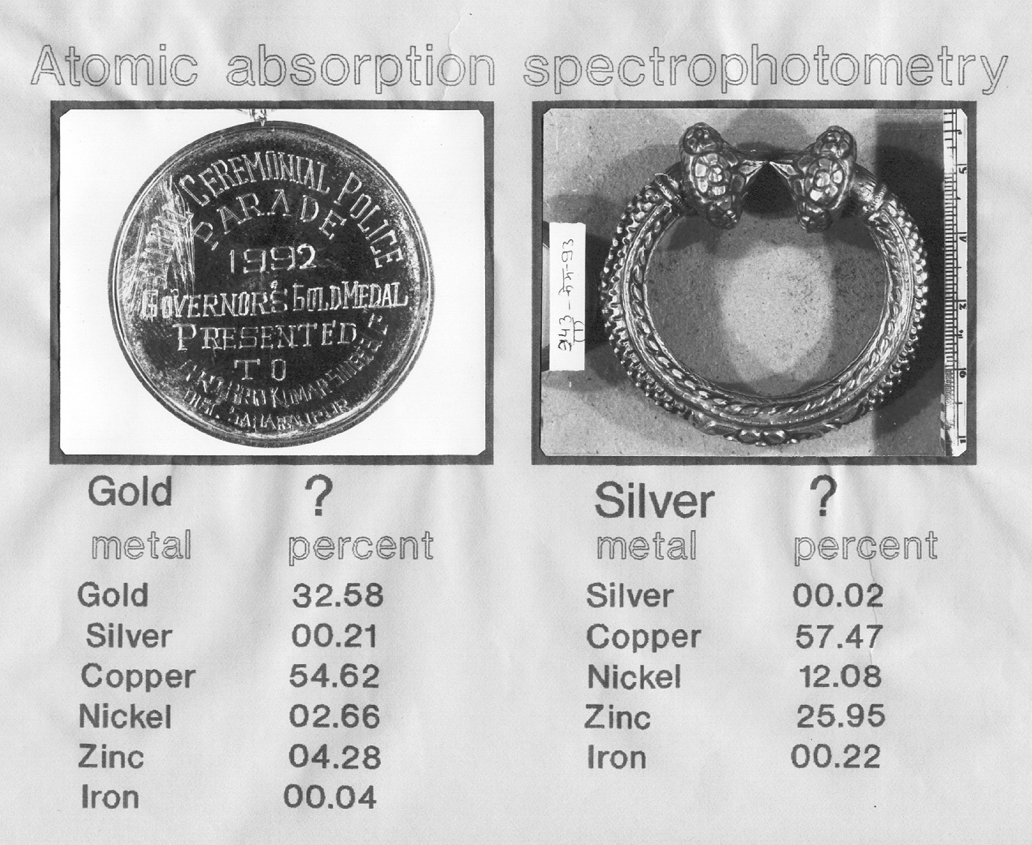
ranbsingh

Slide 20
Ca
Ca
SEM
Microprobe
for multivariate statistical techniques
Inductively Coupled Plasma
and Atomic Absorption Spectroscopy used for quantitative determination of
Mn, Fe, Mg, Al,
Sr, and Ba
in small fragments
(200-500 µg)
Source - type classification
XRF
Ca/Fe
ranbsingh

Slide 21
Levels of
copper, zinc, and arsenic
in human visceral tissues
Tissue
concentration in parts per million
copper
zinc
arsenic
Stomach
2 - 12
8 - 110
0.2 - 1.6
Liver
6 - 32
6 -32
6 - 32
16 - 207
0.6 - 2.0
Kidney
4 - 14
8 - 148
0.4 - 1.9
6 - 32
Spleen
4 - 10
28 - 82
1.0 - 2.1
A A S
A A S
ICP - AES
FSL Lucknow
FSL Agra
ranbsingh

Slide 22
Characterization of Opium Sample
    Identification
    Trafficking Pattern
    Source authentication
Elemental composition of opium, a natural product, varies
from region to region due to various factors, such as:
    Variety of Opium
    Soil composition
    Use of fertilizers
    Method of handling raw opium
    Adulterants
Ran B. Singh

Slide 23
Elemental profiling of Indian Opium samples
Opium cultivation in India is restricted to
Uttar Pradesh, Rajasthan, and Madhya Pradesh
-cultivating regions are classified in 18 divisions
124 samples – in one crop year
ICP – OES used for elemental analysis
Thirteen elements were analyzed
Zn Co Ni Fe Si Mn Mg
Ca Ti Cu Al Sr Ba
Quantitative results were statistically analyzed
-no significant trend was observed
-samples analyzed (124) could be grouped as follows:
55 samples in Group I, 38 samples in Group II
20 samples in Group III, 11 samples scattered
CFSL, Hyderabad Ran B. Singh

Slide 24
Copper Wires by Trace Element profile
Characterization of
(Neutron Activation Analysis)
after twenty years
A priori assumptions
-within agreement,
-between variations
were verified
Trace element profile of
one hundred and eleven
copper wires from actual cases were compiled
Forty five inter-comparisons
were made, and it was shown
that the levels of the elements:
Ag, Au, Se, and Sb could
differentiate all the wires
Six thousand one hundred
and five inter-comparisons
were made. The wires could
be grouped into one hundred
different sources only
The above method was used
to analyze and report on case
samples with confidence
If indistinguishable samples were not
duplicates, the confidence in forming
opinion is affected. Determination of
a few more elements may be essential
ranbsingh

Slide 25
Source authentication
sample size should be guided by qualitative and quantitative uniformity of the material
background levels of substances in a given environment
sensitivity is achieved at the cost of precision
two sets of method of analysis
--for minute (microscopic) samples
--for not so minute samples
of course they will have different precision limits
Databases for the attributes studied may
be used for quantitative estimate of the significance
ranbsingh

Slide 26
Instead of qualitative or semi quantitative analyses of a
large number of elements a smaller number of elements
suitable for quantitative analyses should be selected for
meaningful databases
Suitable statistical methods to meet
the judicial requirement should be chosen
probability of guilt
-association potential of the attribute
probability of innocence
-discriminative potential of the attribute
ratio of the probability of guilt / probability of innocence
ranbsingh

Slide 27
Characterization of Metals by their
Trace Element Profile
Whether
Different Databases on Trace Impurities
can be Shared
Accuracy
- closeness of the measured value
to the true value
Systematic error in
- difference between measured
measurements (bias)
and true values
Standard deviation
- an index of precision
Generation of Analytical data of Known Quality
* Validation of analytical technique
* Quality Assurance Measures
ranbsingh

Slide 28
Thank You
ranbsingh
Notes:
28

